Slide 1
High Performance I/O with NUMA Systems in Linux
Lance Shelton
Notes:
----- Meeting Notes (5/10/13 16:04) -----
Additional info is provided in this section for some slides.

Slide 2
How prevalent is NUMA?
FUIO
N-IO
FUSION-IO
All major vendors
HP, Dell, IBM, Cisco, SuperMicro, Hitachi, etc.
As small as 1U
2, 4, and 8 socket systems
2 to 10 cores per socket
Number of cores doubles with HyperThreading
8 x 10 x 2 = 160 CPU cores
NUMA is mainstream.

Slide 3
Why use large NUMA servers?
FUIO
N-IO
FUSION-IO
NUMA is key to the current evolution of performance
Storage rates are drastically increasing
Processor speeds are stagnant
Multi-core cannot scale infinitely without NUMA
NUMA meets the needs of the application
No partitioning is required
Faster than clustering multiple servers
Works well in combination with scale out

Slide 4
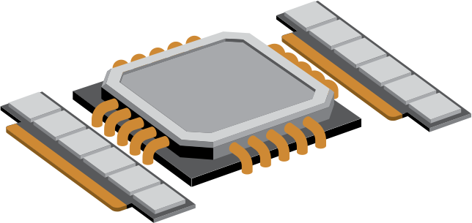
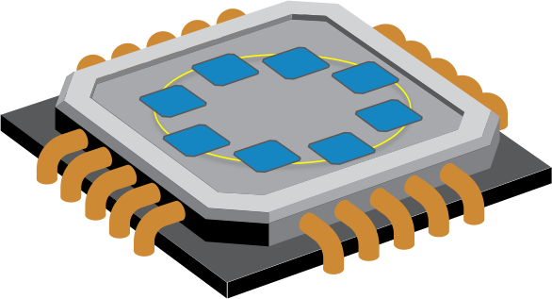
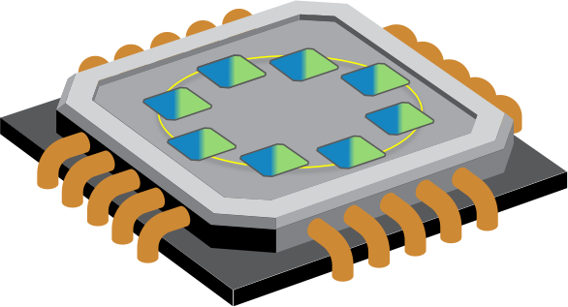
Nodes, Sockets, Cores, Threads
FUIO
N-IO
FUSION-IO
+
=
Memory
Socket
NUMA Node
Cores
Threads

Slide 5
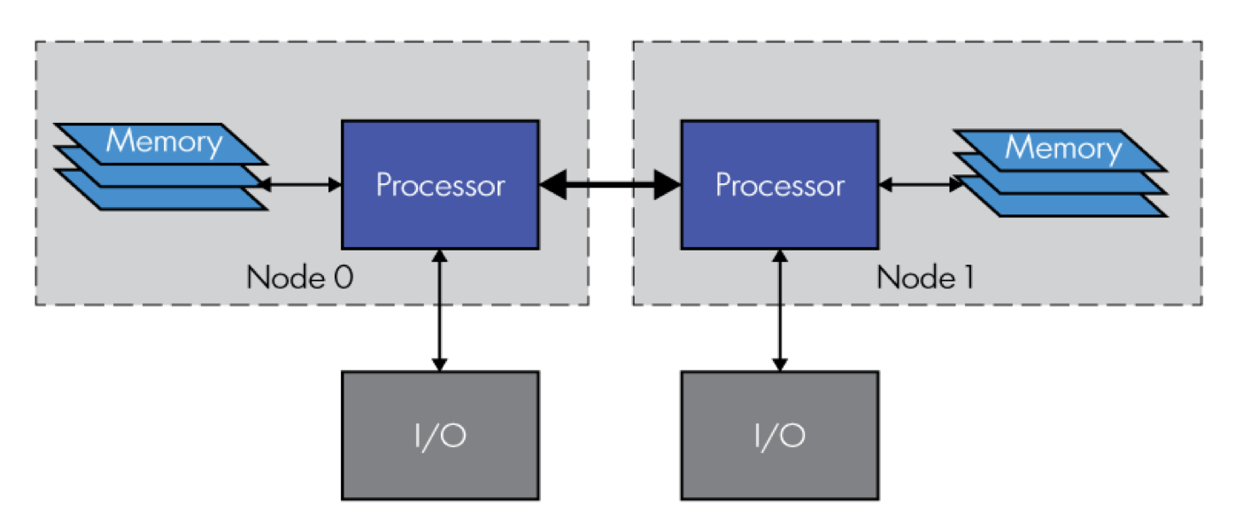
Non-Uniform I/O Access
FUIO
N-IO
FUSION-IO
I/O = PCIe
Internal flash
Host bus adapter
to storage network
Notes:
----- Meeting Notes (5/10/13 16:05) -----
In addition to memory access, I/O access is also non-uniform.

Slide 6
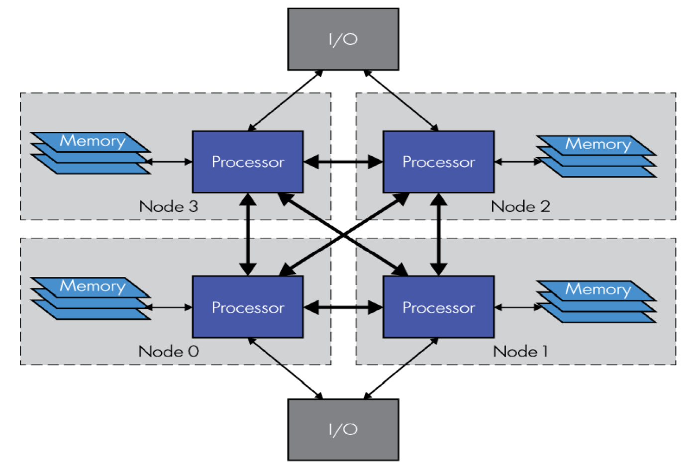
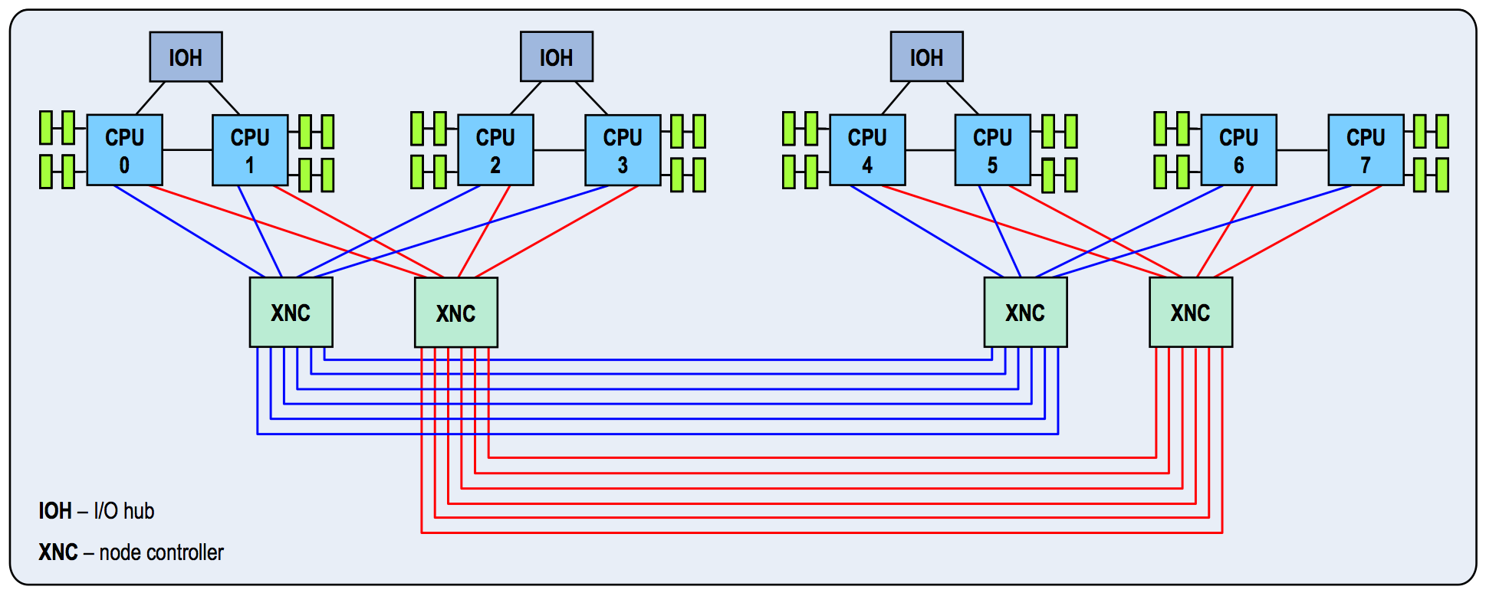
2, 4, and 8 Socket Servers
FUIO
N-IO
FUSION-IO
# numactl --hardware
node 0 1 2 3 4 5 6 7
0: 10 12 17 17 19 19 19 19
1: 12 10 17 17 19 19 19 19
2: 17 17 10 12 19 19 19 19
3: 17 17 12 10 19 19 19 19
4: 19 19 19 19 10 12 17 17
5: 19 19 19 19 12 10 17 17
6: 19 19 19 19 17 17 10 12
7: 19 19 19 19 17 17 12 10
Notes:
----- Meeting Notes (5/10/13 16:05) -----
pictured: HP DL380p, DL580, DL980 (up to 160 CPU threads); numactl displays the distance between NUMA nodes

Slide 7
Enterprise Storage
FUIO
N-IO
FUSION-IO
Storage
Database Servers
Clients
Notes:
----- Meeting Notes (5/10/13 16:05) -----
Storage is connected to the database servers via FibreChannel, Infiniband, or iSCSI. Database servers are connected to clients via Ethernet. Without optimizing database servers, backend storage performance is not fully realized.

Slide 8
PCIe Local Nodes
FUIO
N-IO
FUSION-IO
Intel Nehalem
Intel Sandy Bridge
I/O Hub
Notes:
----- Meeting Notes (5/10/13 16:06) -----
I/O Hubs and sockets are connected via QPI. Westmere arch is the same as Nehalem. Ivy Bridge is the same as Sandy Bridge.

Slide 9
PCIe Local Nodes
FUIO
N-IO
X
FUSION-IO
# cat /sys/devices/pci0000:50/0000:50:09.0/numa_node
0
Only one local node is presented to the OS
Intel Nehalem
Intel Sandy Bridge
X
I/O Hub
Notes:
----- Meeting Notes (5/10/13 16:06) -----
Note that the second QPI link from the I/O Hub will still be used, it is just not recognized as a local connection.

Slide 10
PCIe Local Node?
FUIO
N-IO
FUSION-IO
# cat /sys/devices/pci0000:50/0000:50:09.0/numa_node
-1
Not detected? Update the BIOS.
Intel Nehalem
Intel Sandy Bridge
?
?
?
I/O Hub
?
Notes:
----- Meeting Notes (5/10/13 16:06) -----
NUMA info is provided by the System Locality Information Table (SLIT) in ACPI.

Slide 11
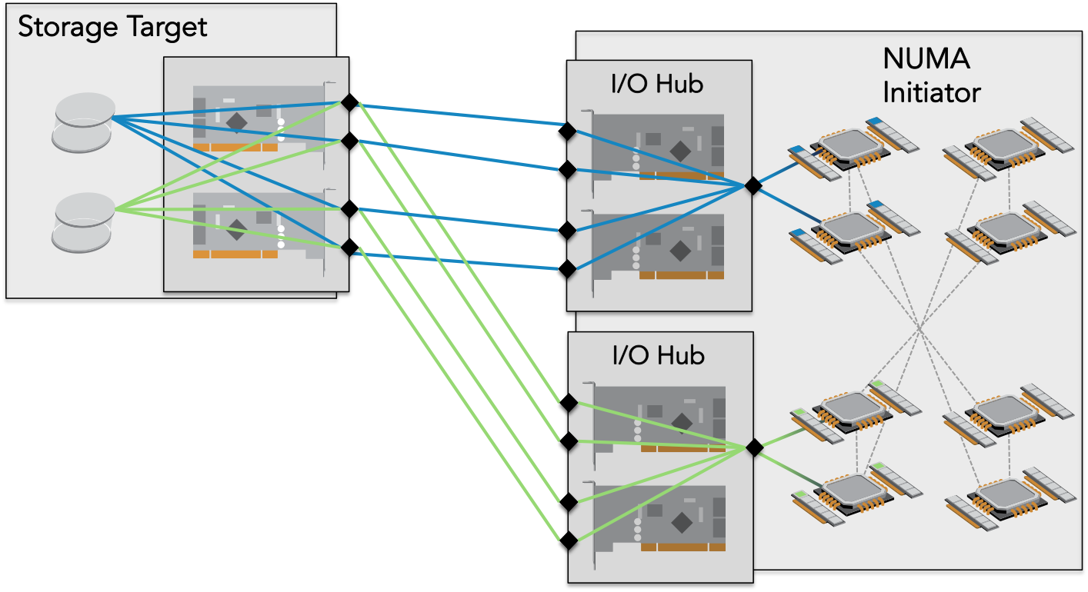
Localizing I/O from Storage
FUIO
N-IO
FUSION-IO
50-100% performance improvement vs. non-NUMA aware volume placement

Slide 12
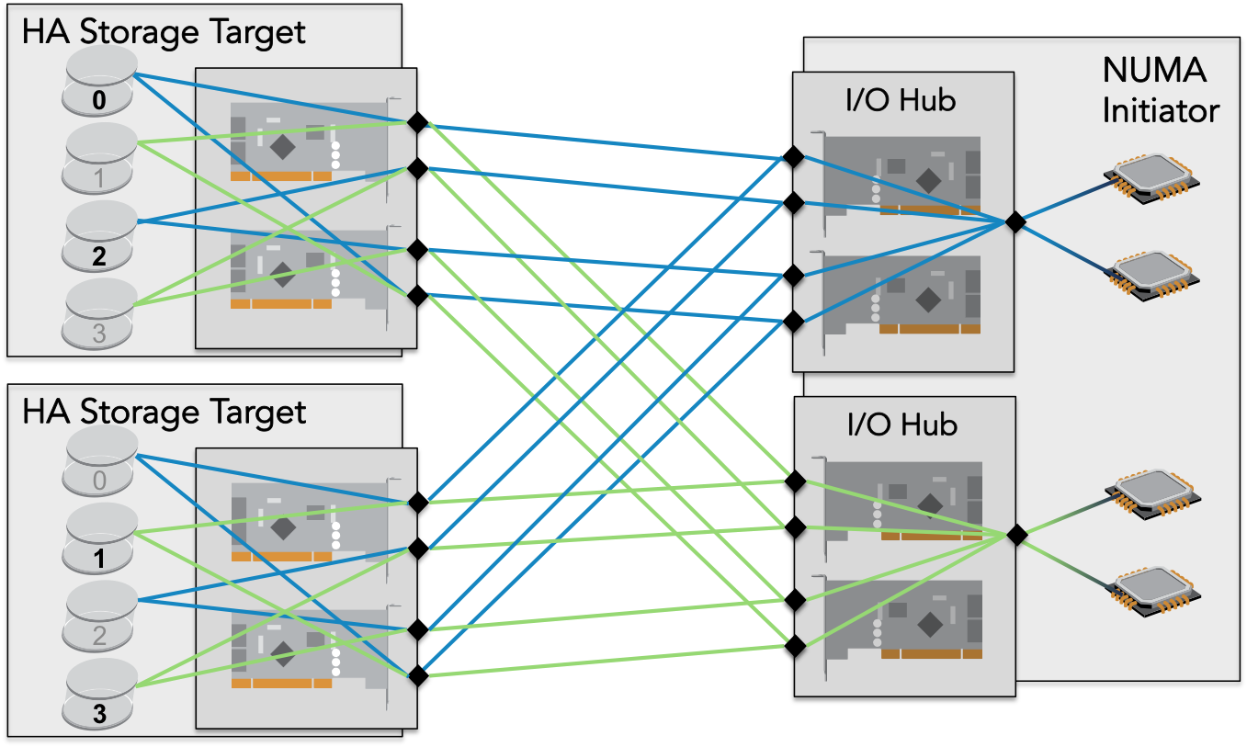
Localizing I/O – High Availability
FUIO
N-IO
FUSION-IO
Node locality of volumes must still be maintained

Slide 13
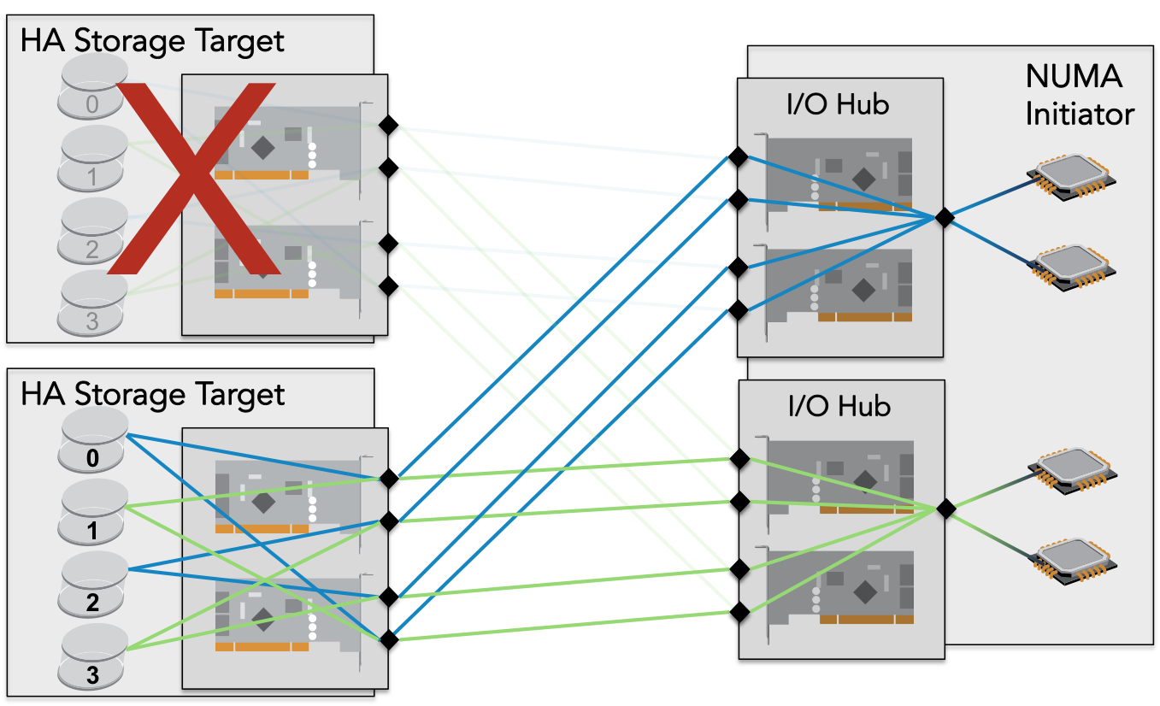
Localizing I/O – HA Failover
FUIO
N-IO
FUSION-IO
Node locality maintained
All available ports are still used

Slide 14
Localizing I/O – Components
FUIO
N-IO
FUSION-IO
HBA placement
Interrupt affinity
Kernel thread affinity
Application affinity
Analyze everything in the data path.
Localize all components to the HBA local nodes.
Reduces latency and improves caching

Slide 15
Discovering Device Locality
FUIO
N-IO
FUSION-IO
Devices associated with each volume
multipath –ll
ls -d /sys/bus/pci/devices/*/host*
Device location
dmidecode -t slot
lspci -tv
NUMA node of devices
/sys/devices/pci*/*/numa_node
?
?

Slide 16
Pinning Interrupts
FUIO
N-IO
FUSION-IO
Pin IRQs to the local node
Distribute IRQs between cores in the local node
# grep [driver] /proc/interrupts
[num]: ...
# cat /proc/irq/[num]/node
[node]
# echo [CPU mask] > /proc/irq/[num]/smp_affinity
~100% improvement
Reduces latency & CPU contention, improves caching
121
122
123
120
…
Notes:
----- Meeting Notes (5/10/13 16:07) -----
These settings are not persistent

Slide 17
Persistently Pinning Interrupts
FUIO
N-IO
FUSION-IO
irqbalance: run-time load balancing
Mixed results
Better with RHEL 6.4 + kernel update + Sandy Bridge
Customized init service to set affinity on boot
Best results for a known application
Notes:
----- Meeting Notes (5/10/13 16:07) -----
Some IRQs perform better when grouped, while extremely high-usage IRQs perform best on separate cores. In some cases, tuning for bandwidth requires a different grouping than tuning for IOPS.

Slide 18
Driver Kernel Thread Affinity
FUIO
N-IO
FUSION-IO
Sometimes handled by Linux drivers
Verify and adjust
# taskset -p -c [cpumask] [pid]
pid [pid]'s current affinity list: 0-159
pid [pid]'s new affinity list: 20-29
Notes:
----- Meeting Notes (5/10/13 16:07) -----
Sometimes kernel threads cannot be pinned from userspace.

Slide 19
Block Device Tuning
FUIO
N-IO
FUSION-IO
# echo noop > /sys/block/[device]/queue/scheduler
10% improvement
# echo 0 > /sys/block/[device]/queue/add_random
10% improvement
# echo 2 > /sys/block/[device]/queue/rq_affinity
5% improvement
# echo [0 or 1] > /sys/block/[device]/queue/rotational
Mixed results
Reduces latency and CPU utilization
Notes:
----- Meeting Notes (5/10/13 16:08) -----
Flash storage latency is fairly consistent and thus does not provide a useful contribution to the entropy pool (add_random). Rotational seems to impact how adjacent small I/Os are combined, in a way that is in some cases beneficial to non-rotational devices.

Slide 20
Persistent Block Device Tuning
FUIO
N-IO
FUSION-IO
udev rules (/etc/udev/rules.d/)
I/O devices
ACTION=="add|change", SUBSYSTEM=="block", ATTR{device/vendor}=="FUSIONIO", ATTR{queue/scheduler}="noop", ATTR{queue/rq_affinity}="2", ATTR{queue/add_random}="0”
devices with I/O slave devices (DM multipath)
ACTION=="add|change", KERNEL=="dm-*", PROGRAM="/bin/bash -c 'cat /sys/block/$name/slaves/*/device/vendor | grep FUSIONIO'", ATTR{queue/scheduler}="noop", ATTR{queue/rq_affinity}="2", ATTR{queue/add_random}="0"
Note: udev rules may only rely on sysfs parameters that are available at the time the device is created.
Notes:
----- Meeting Notes (5/10/13 16:08) -----
The udev daemon runs when the KOBJ_ADD uevent fires, which is triggered by device_register(). Use of any sysfs files created after device_register() may introduce race conditions in udev rules.

Slide 21
Power/Performance Tuning
FUIO
N-IO
FUSION-IO
Disable c-states in the BIOS
Disable c-states in the boot loader (grub)
intel_idle.max_cstate=0
processor.max_cstate=0
10% improvement
Keeping processors in active states reduces latency
Notes:
----- Meeting Notes (5/10/13 16:08) -----
Only one of these methods is necessary, but it varies from platform to platform. Verify that /sys/devices/system/cpu/cpu0/cpuidle does not exist to be sure.

Slide 22
Application Tuning
FUIO
N-IO
FUSION-IO
OS-provided tools
taskset
cgroups
numad
Application-specific settings
Oracle
_enable_NUMA_support

Slide 23
Benchmarking Performance
FUIO
N-IO
FUSION-IO
Test thread affinity
FIO
cpus_allowed
numa_cpu_nodes
numa_mem_policy
Oracle Orion and others
taskset -c [cpulist] [test command]
Measuring performance
iostat
Application-specific

Slide 24
8 Socket Total Performance Gains
FUIO
N-IO
N-IO
FUSION-IO
4k block size iops
READS WRITES
Notes:
----- Meeting Notes (5/10/13 16:09) -----
Even greater gains in performance are possible - this configuration was tuned up to the limitations of the hardware. Further gains are in development.

Slide 25
Tools for NUMA Tuning
FUIO
N-IO
FUSION-IO
numactl cgroups
taskset lstopo
dmidecode sysfs
irqbalance numad
top numatop
htop tuna
irqstat tuned-adm

Slide 26
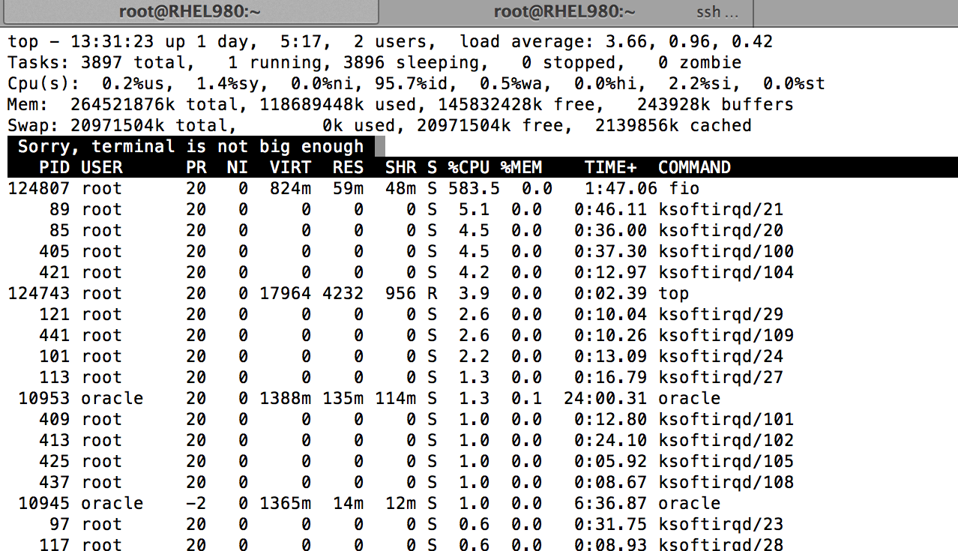
top: terminal is not big enough
FUIO
N-IO
FUSION-IO
(top in RHEL 6.4)

Slide 27
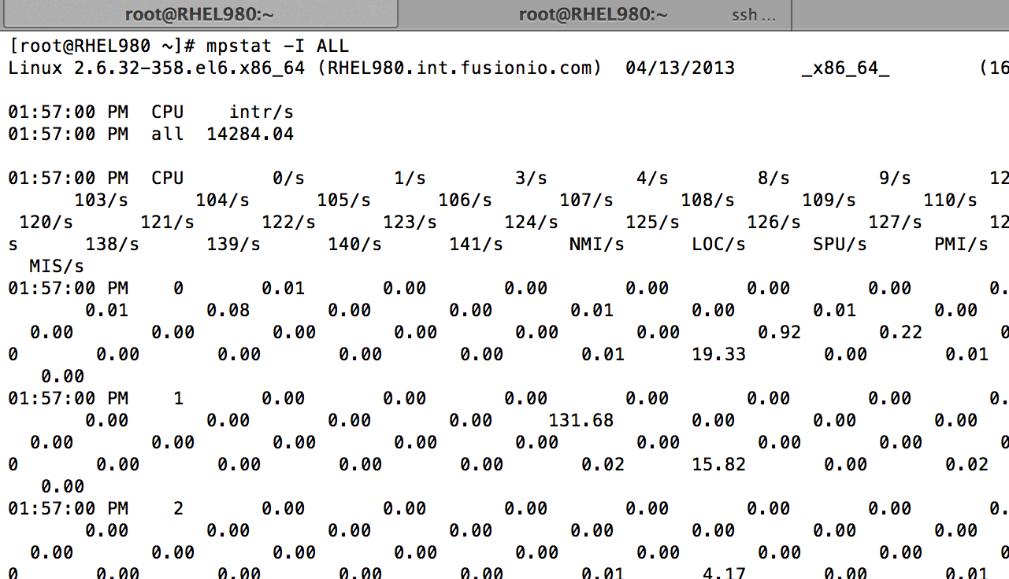
mpstat with 160 cores
FUIO
N-IO
FUSION-IO

Slide 28
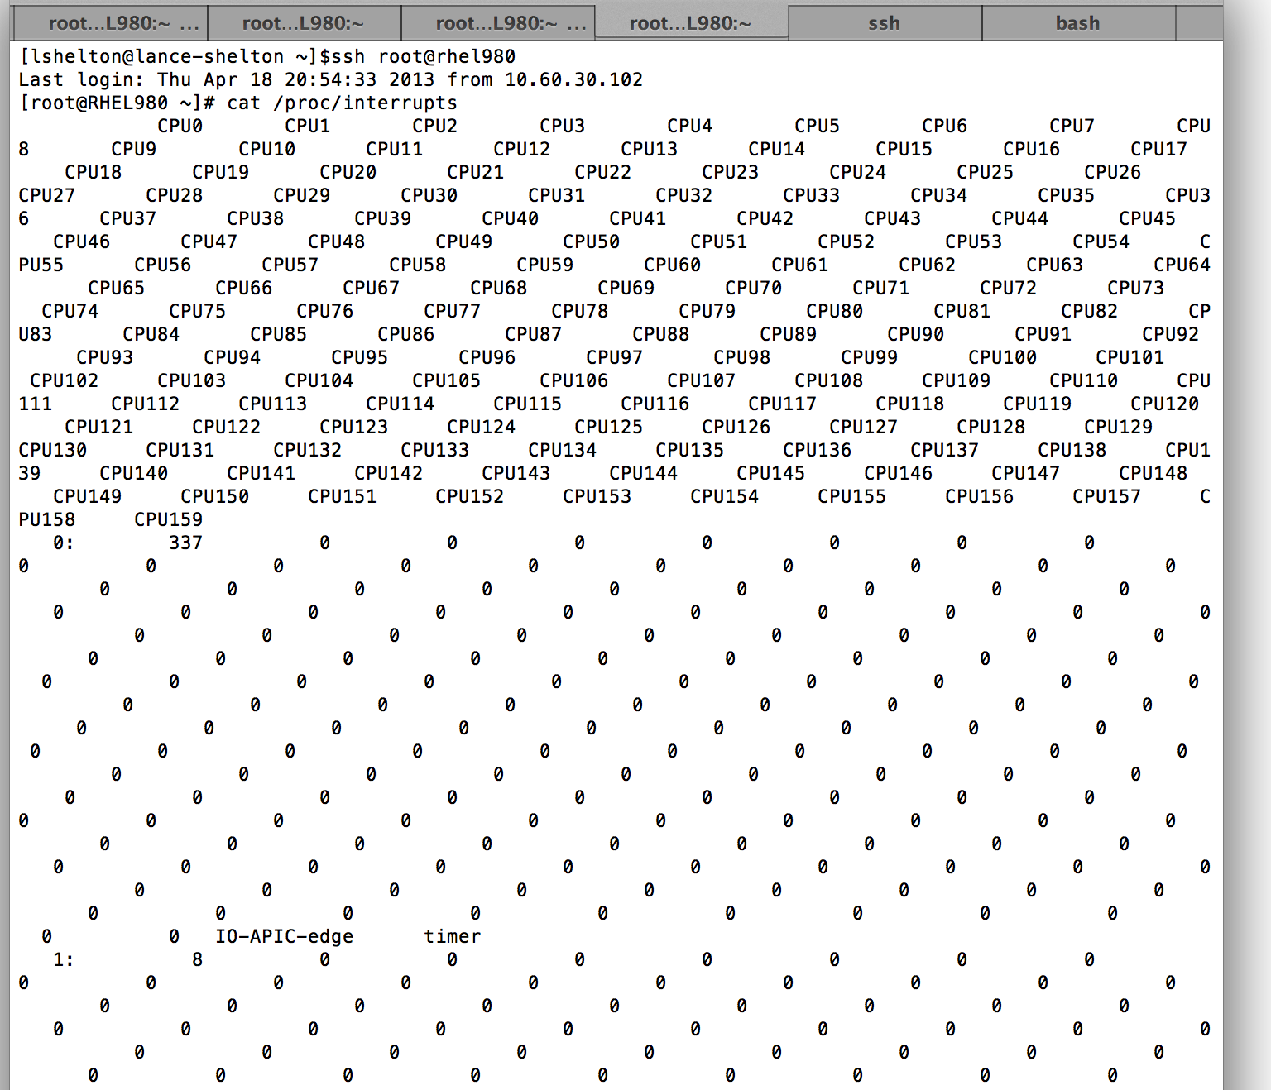
/proc/interrupts with 160 cores
FUIO
N-IO
FUSION-IO

Slide 29
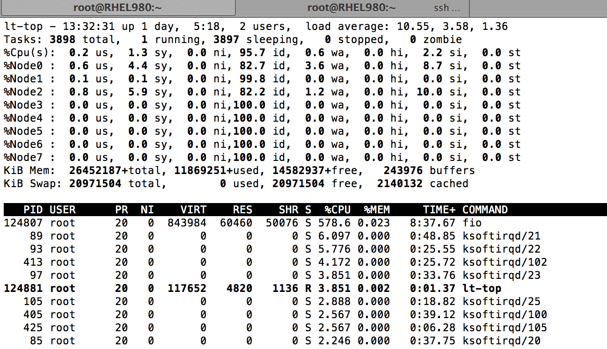
top: added NUMA support
FUIO
N-IO
FUSION-IO
https://gitorious.org/procps/procps

Slide 30
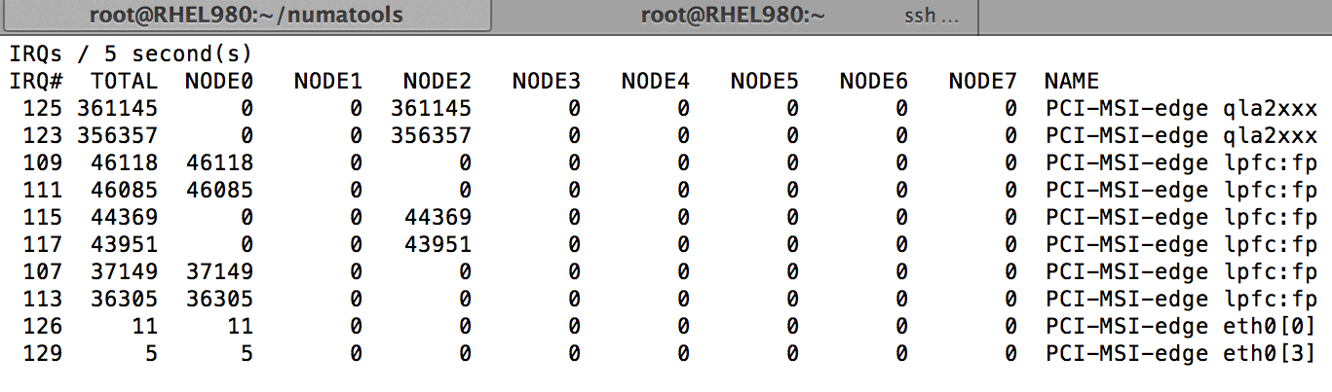
irqstat: IRQ viewer for NUMA
FUIO
N-IO
FUSION-IO
https://github.com/lanceshelton/irqstat

Slide 31
Must end users be NUMA-aware?
FUIO
N-IO
FUSION-IO
Unfortunately, yes.
Users must be aware of PCIe device slot placement
Optimal NUMA tuning is not yet performed by the OS
Persistent tuning is a non-trivial task
Performance challenges are changing faster than tools

Slide 32
How can this be improved?
FUIO
N-IO
FUSION-IO
NUMA architectures must be detected properly and tuned by default
Phase out Nehalem or add SLIT support for multiple local nodes
Linux distributions need to provide optimal tuning across applications and devices at the OS level
Improve existing tools

Slide 33
What’s next?
FUIO
N-IO
FUSION-IO
More cores per socket
15 core CPUs by the end of next year?
Removal of existing bottlenecks
Multi-queue block layer: http://kernel.dk/blk-mq.pdf
Improved tools
numatop: https://01.org/numatop
top: https://gitorious.org/procps/procps
irqstat: https://github.com/lanceshelton/irqstat

Slide 34
References
FUIO
N-IO
FUSION-IO
HP DL980 Architecture
http://h20195.www2.hp.com/V2/GetPDF.aspx/4AA3-0643ENW.pdf
HP NUMA Support
http://bizsupport1.austin.hp.com/bc/docs/support/SupportManual/c03261871/c03261871.pdf
Performance profiling methods
http://dtrace.org/blogs/brendan/2012/03/07/the-use-method-linux-performance-checklist/

Slide 35
LShelton@fusionio.com

